Slide 1
MDDI Final Project Proposal
Term 2
Brandon Cernohous 29/03/2023

Slide 2
The project

Slide 3
The problem
There are hundreds of additive manufacturing systems, materials, and many different slicers. While additive manufacturing systems have gotten better at being accessible, it still takes an extensive amount of knowledge, time, and background to master these machines.
Approx 2.5 million 3D printers sold last year
The lack of expertise causes a massive waste of time and material. It also leaves users unable to further adopt the technology to maximum potential
I have personally helped over 500 customers figure out how to AquaSys products on over 100 systems
There are few centralized places to find high quality information on systems, materials, software, and how they interact.
To date, the best 3d community I have experienced is on Reddit (which is full of misinformation)

Slide 4
Proposal - 3D Printing Community
Create an online network/database for people to upload print profiles while capturing the following information
Print parameters
Hardware used - including modifications
Exact material used
Allow users to download profiles for their system (or the most similar available)
Allows users to compare profiles to make educated guesses for doing new materials or new equipment
Include a rating system for the overall quality of the profile
Create a discord channel - Connect experts to users
Provide information on materials selection and differences
Provide a space for users to discuss and troubleshoot applications
Reduced wasted time and material, and enable broader adoption of 3d printing

Slide 5
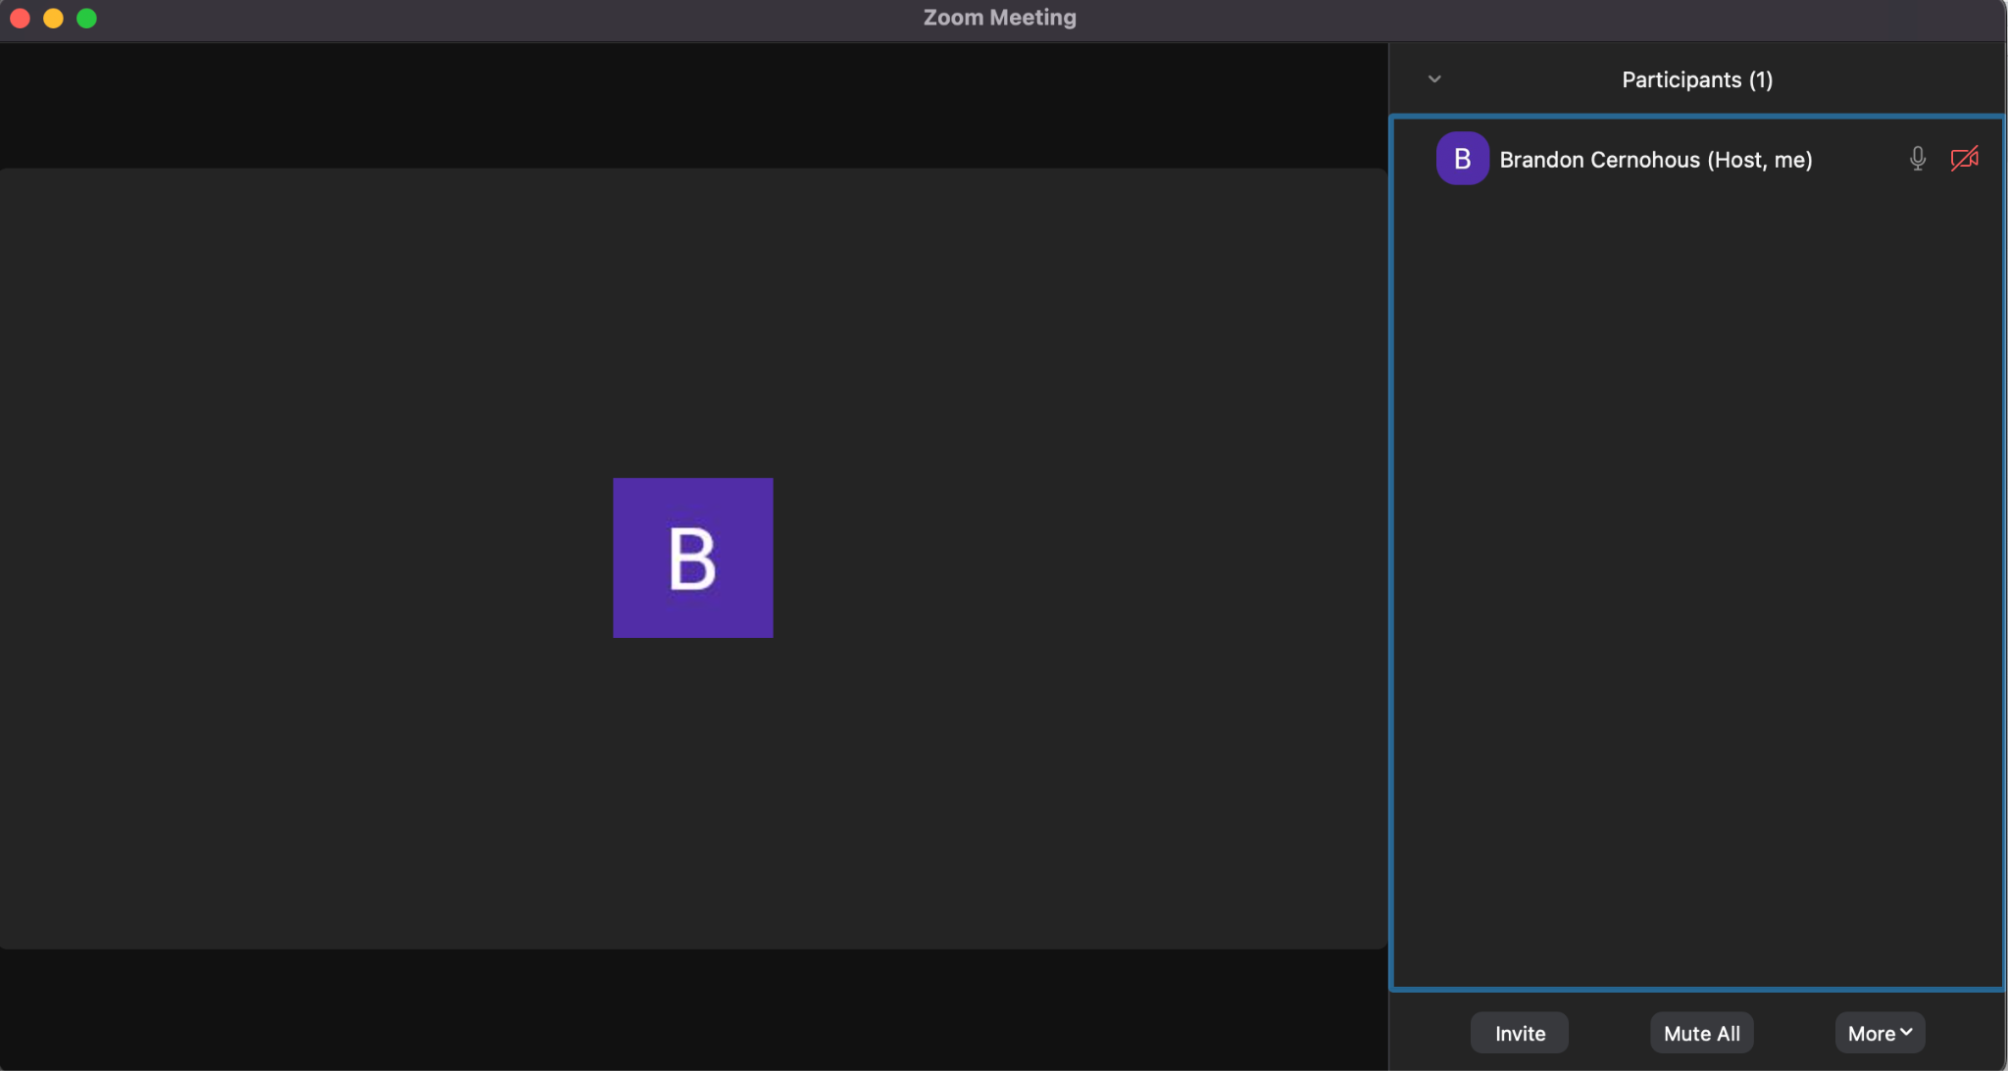
Intervention 1 - Underwhelming
My first intervention was to attempt to connect with local makerspaces, fablabs, etc to discuss the project and gain feedback
I made contact by email and phone to set up a Zoom meeting to discuss the concept of the project and get feedback from the local 3d printing community.
5 of 10 people responded via email.
Most email responses were the following: “Your project sounds interesting, but I have no time or desire to participate in any way”
0 of 10 people attended the 1st scheduled meeting
A very lonely zoom room….

Slide 6
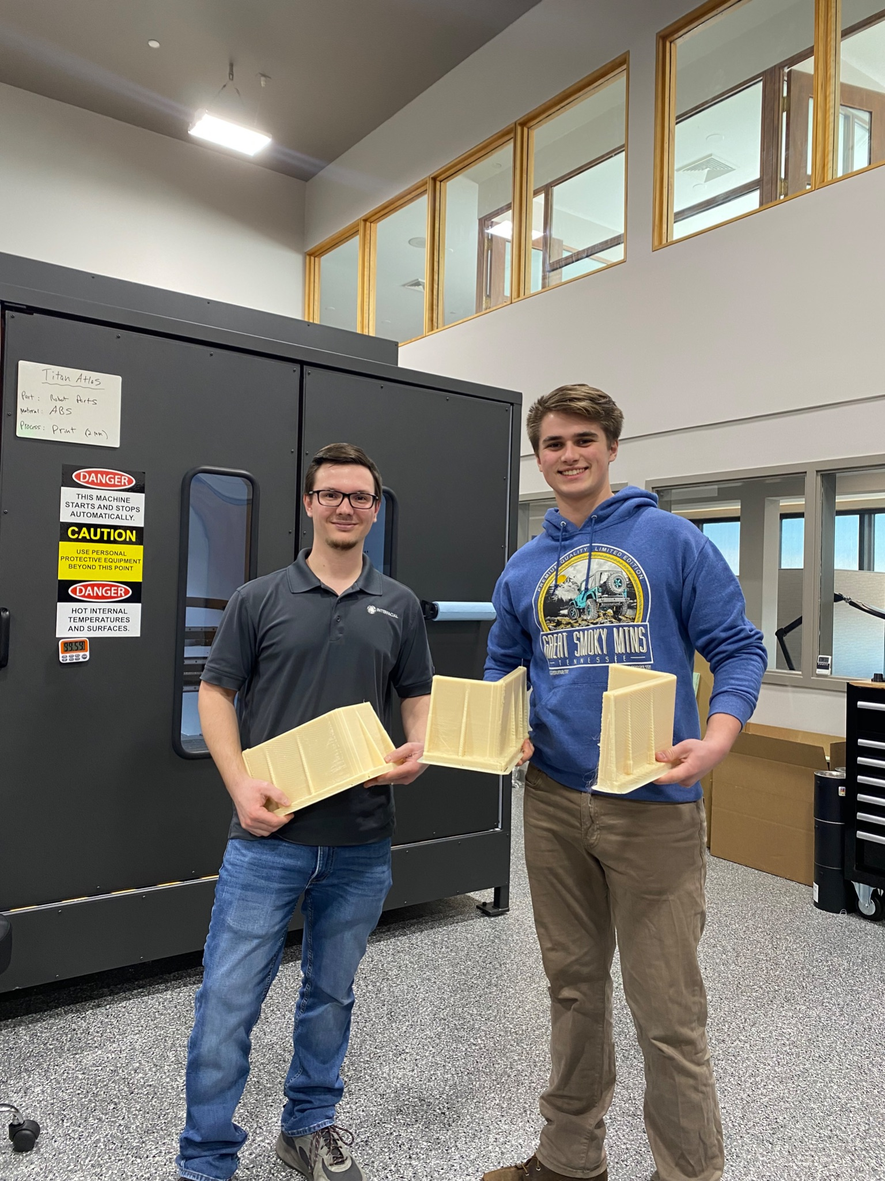
Intervention 2 - Students
The “Robocats” a local high school robotics club
Two teachers, and 20 students
They have access to a few entry level printers and many students had an entry level printer at home
The students were heavily reliant on the teachers for advice
The teachers did not have significant background to do more than very basic troubleshooting
Used Reddit and Youtube as the primary source of information
PLA and PETG were the only materials used
Overall the group was very excited about the concept and a connection to industry experts

Slide 7
Intervention 3 - Digital Community
Create a discord channel to build
Contact industry professionals to provide expert level support and information
Stratasys, Makerbot, Ultimaker, Intamsys, Arburg, Raise, Aon
Braskem, Polymaker, 3Domfuel,
Connect struggling end users with true experts
Add local users to the discord - Makerspaces etc
https://discord.gg/hp7xewF8
8 users so far….
Sending invite to the Robocats
Investigate building a forum
Forums exist
Content is poor and focused on entry level machines

Slide 8
Full Stack
Community
Help individual users solve each others problems. Create a space (digital/physical) for local users to connect and learn. Engage with makerspaces.
Many users have dabbled in 3d printing, but have run into knowledge gaps, and are discouraged from broader implementation.
Territory
Connect users, makerspaces, and manufacturers(printer OEMs, material manufacturers, and companies adopting AM). Stop the spread of misinformation.
Gives users the ability to use regionally sourced products.

Slide 9
Full Stack
Planetary -
Most 3d printing raw materials are petroleum based.
There is virtually no recycling stream for any 3d material
Even PLA as the most “eco friendly” material still requires industrial composting (a rare service)
Most users (especially with higher end systems) purchase materials directly from the printer manufacturer. This means that most materials are mass produced and shipped globally, because it is easier to use materials known to work with a give machine, then to figure it out.
By reducing wasted material(failed prints), shorten the distance material needs to travel(by helping users use locally sourced materials), enable corporations to adopt DIDO model, and by saving wasted time from people repeating efforts.

Slide 10
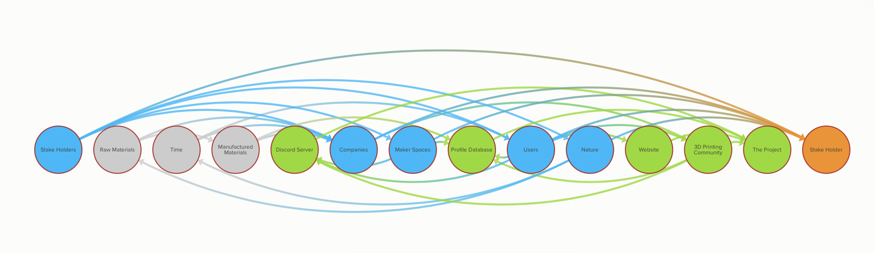
Value Distribution

Slide 11
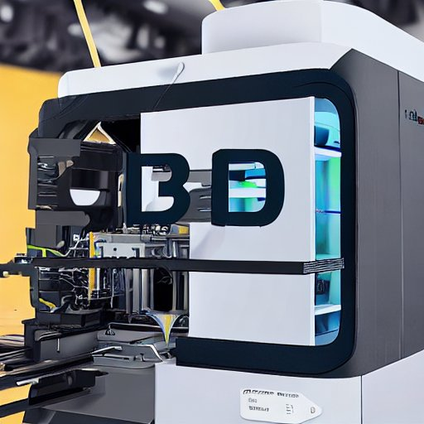
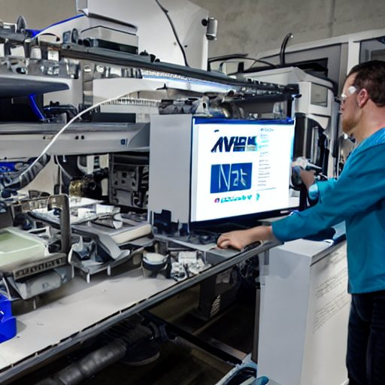
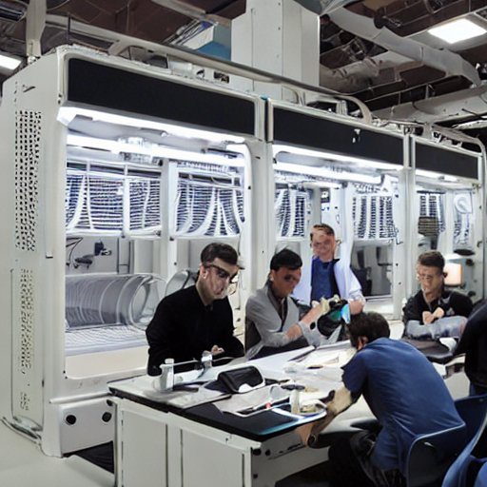
Future State

Slide 12
Reflection/Conclusions
Engaging individuals is difficult. Even existing professional connections.
My experience in the additive manufacturing industry tells me that the project is worthwhile.
I have talked to tons of people who get stuck, or never get past using PLA
Users who need help immediately understand
Existing resources are scattered, unfocused, full of misinformation

Slide 13
Thanks

